Slide 1



Search Tutorial

Slide 2

4. Python Implementation

Slide 3

Debug
Break point
F7 (Step into)
F8 (Step Over)
F9 (Resume)
Monitor variable
Make good use of test_for_debug.py

Slide 4
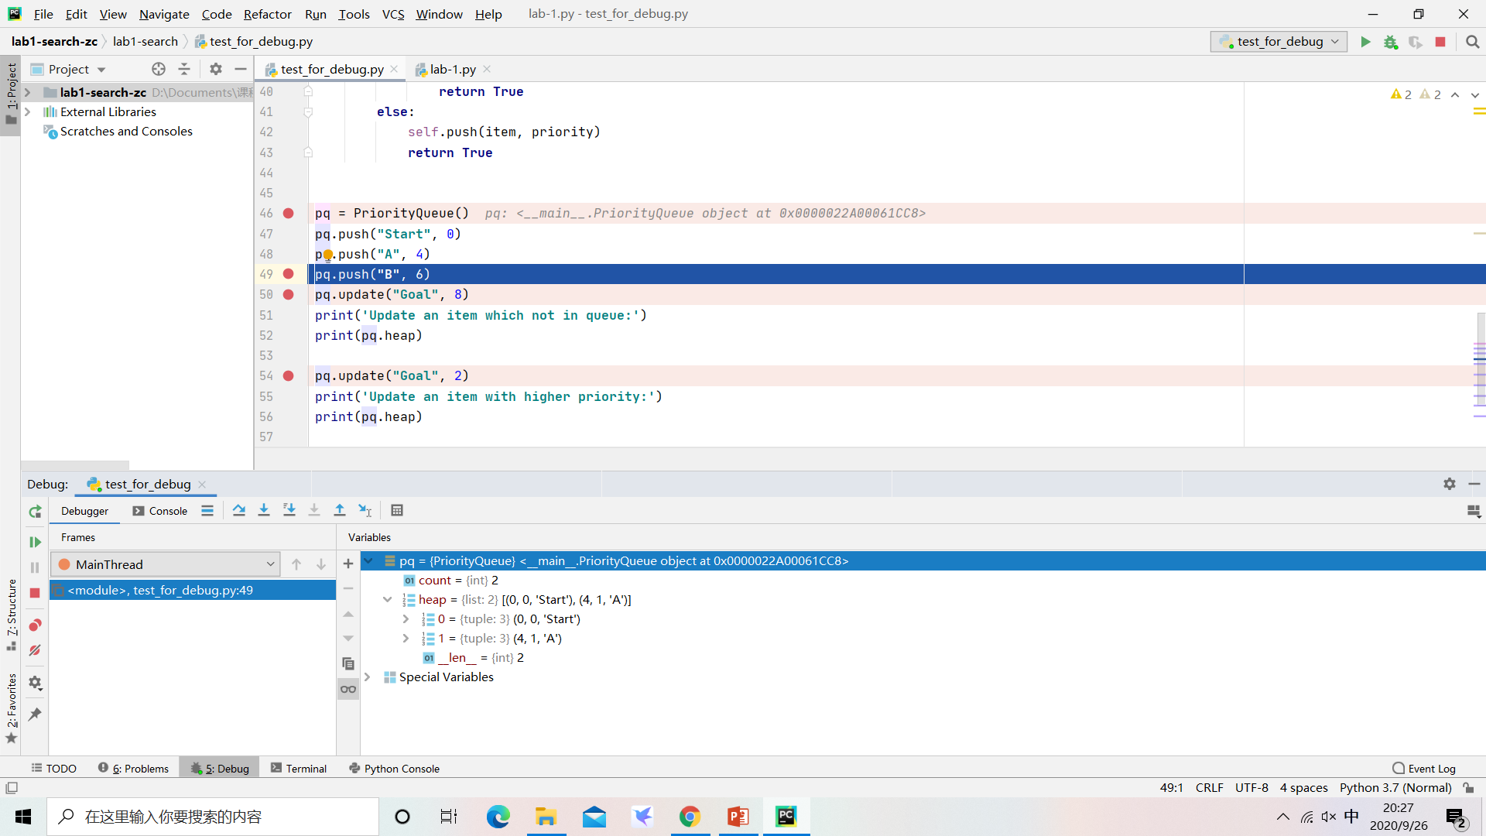
Debug
variable

Slide 5

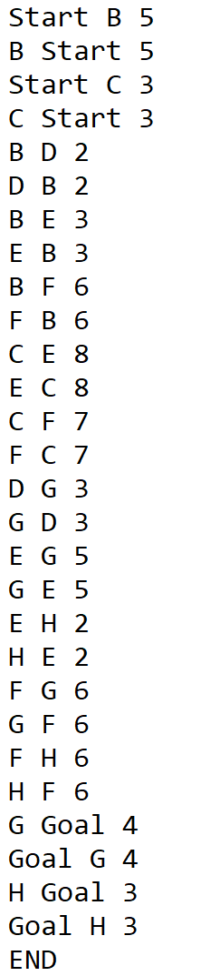
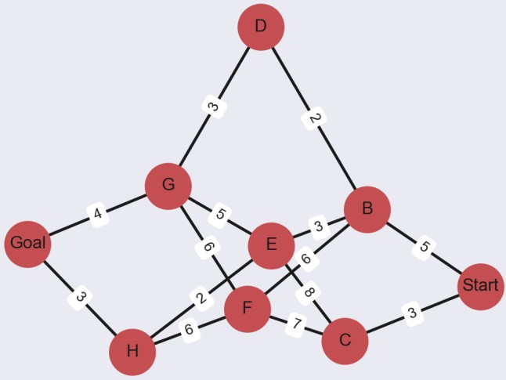
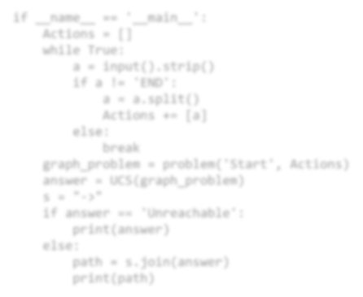


I/O
Input
testcases --> “input(num).txt”
if name == ' main ':
Actions = []
while True:
a = input().strip() if a != 'END':
a = a.split() Actions += [a]
else:
break
graph_problem = problem('Start', Actions) answer = UCS(graph_problem)
s = "->"
if answer == 'Unreachable': print(answer)
else:
path = s.join(answer)
print(path)
Output
testcases --> “output(num).txt”

Slide 6
Code Logic
PriorityQueue
Data Structure
problem
search actions: given a node, return possible actions
solution: return a list containing nodes in optimal path
transition: given a state and specific action, return next state
goal test: given a node, return whether the node matches the goal
step cost: given inherited nodes and action, return step cost
child node: given a node and specific action, return child node
UCS(problem)
implement the search process

Slide 7
OJ
http://10.192.9.85
Register with your ID
Test on your own

Slide 8
Lab for Search
Task
Implement Uniform-Cost Search in Python
Time limits: 2000 ms
Pass the test to get the full score! (as participation grade)
DDL
Environment
http://10.192.9.85
Python 3
Suggest using Pycharm to test (automatically identify line break)

Slide 9


